Slide 1
A Search Engine for the Jewish Bookshelf
Ilana sloutsky
Dmitry tunik
adviser: Oren mishali
Additional Documentation: https://github.com/TechnionTDK/jbs-ir

Slide 2
The Context
The project is a part of the Jewish Bookshelf ecosystem (JBS) in the Technion Data and Knowledge Lab
In the JBS project, hundreds of thousands of JSON objects that represent Jewish texts are produced and used
A potential users of this data:
A data scientist, who needs to research and analyze this corpus of data
An average user, who would like the data to be accessible in a straightforward way

Slide 3
Project Goal
We would like to make the produced Jewish texts accessible for end users
The natural solution – a search engine
It appears that there is no open and comprehensive “Google-like” search engine for Jewish texts

Slide 4

Our Solution
After studying the domain, the task and the users needs, we decided to use COTS (Component Of The Shelf) software solutions
The challenges in this type of project
Selecting the best suiting software for our needs
Researching the selected software
Learning how to install and customize it for our domain
Integrating with other components of the system

Slide 5

SOLR-based Search Engine
After exploring a few options, based on several considerations, we selected
Apache Solr 6 to be our search platform (http://lucene.apache.org/solr)
HebMorph to be the analyzer for Hebrew text (https://github.com/synhershko/HebMorph)
Visit our GitHub repository

Slide 6
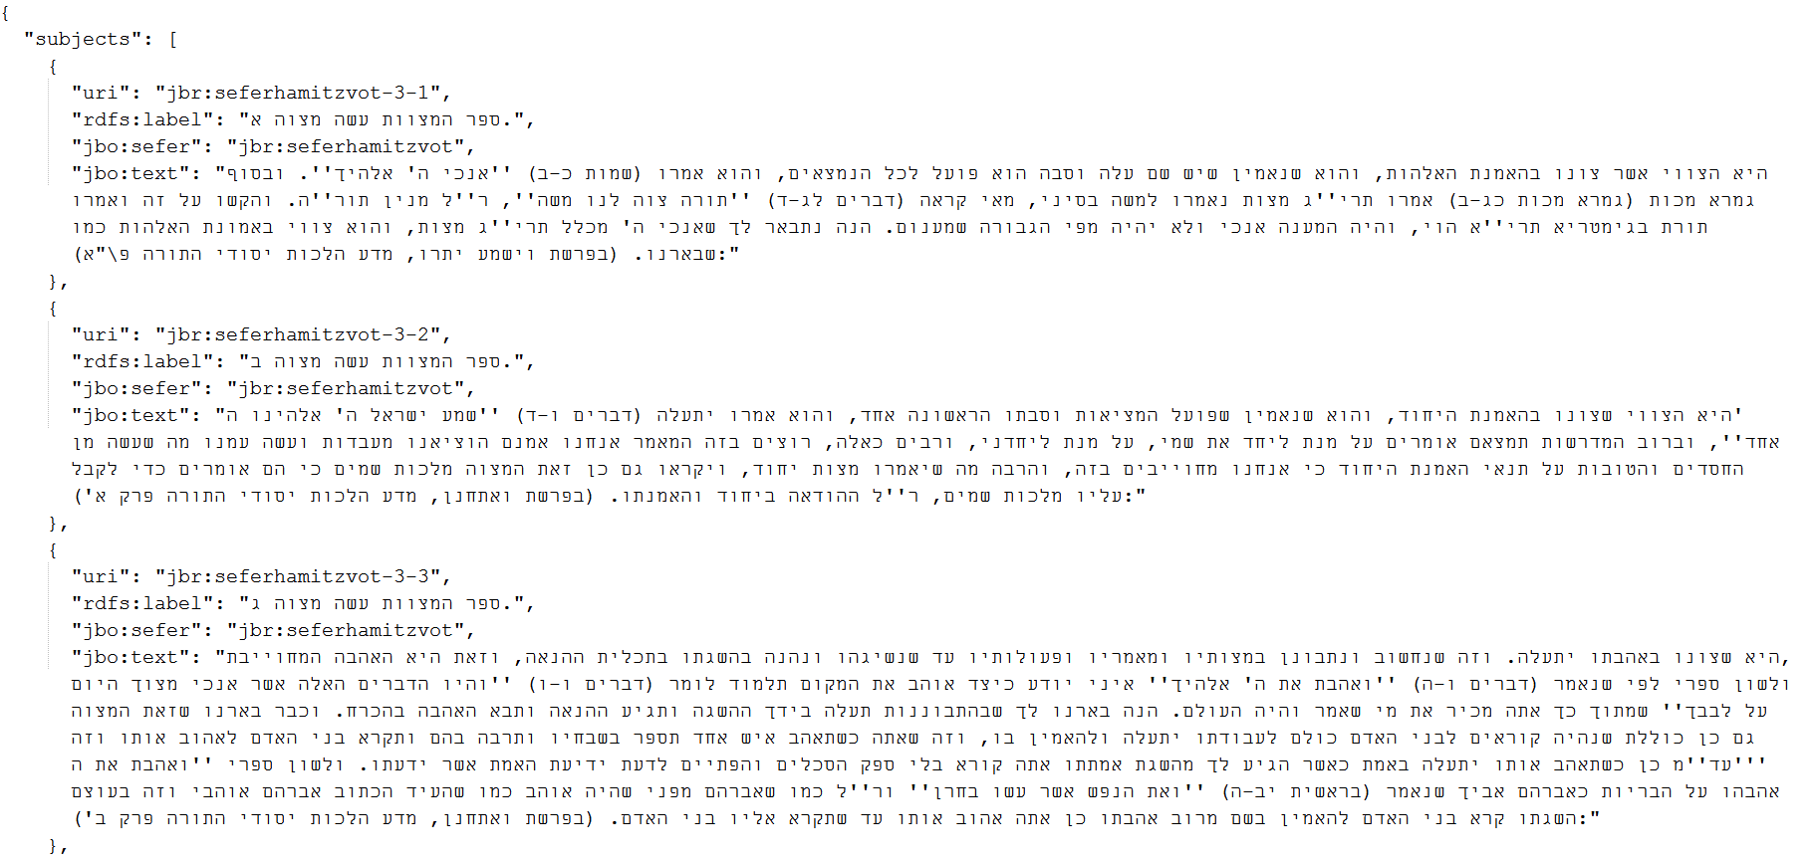
JBS text repository as our input
JBS text repository contains text files in JSON format which were created from the raw texts in Torat Emet website
Each JSON object is considered as a “document” by the search engine.
In this example we see three JSON objects

Slide 7
Project Architecture
The diagram presents the design of the system and the interaction of the key components
The core of the project is the integration and configuration of Solr
The other components support the engine to allow as fluent operation as possible

Slide 8
Project Deliverables
Configured Solr search engine suited for the JBS end users
Including integration of HebMorph
Tools for administrator
Integration with JBS text project (using JsonParser tool)
Customizable evaluation tool
Solr’s built-in admin UI
Full documentation regarding installation, usage and maintenance
Clean and simple website for searching

Slide 9
Apache Solr
An open source enterprise search platform
Runs as a standalone full-text search server
Uses the Lucene Java search library at its core for full-text indexing and search
Solr's external configuration allows it to be tailored to many types of applications without coding

Slide 10

Solr configuration
We use Okapi BM25 which is considered to be a state-of-the-art ranking function
We adjusted Solr core for our task using the following
Defined which fields in the .json files are indexed and searchable
Set HebMorph as our analyzer
Read more about the modifications in our Wiki
Notes:
BM25
https://www.elastic.co/guide/en/elasticsearch/guide/current/pluggable-similarites.html

Slide 11
HebMorph
We use HebMorph as our Hebrew analyzer for both indexing and querying
HebMorph is an open-source effort for making Hebrew properly searchable by various IR software libraries
Since HebMorph is more suitable for modern Hebrew, we don’t see optimal results for ancient texts in our domain – which is written in biblical Hebrew
Still, we get better results with Hebmorph than without it

Slide 12




HebMorph key features
HebMorph allows us to remove Niqqud and lemmatize Hebrew words
For example, the word turns into the base form of
And becomes
Therefore, we are able to improve our search results
For additional examples, visit our Wiki
Notes:
HebMorph Wiki: https://github.com/TechnionTDK/jbs-ir/wiki/HebMorph-Analysis-Example

Slide 13

JSON Parser tool
In order to build the index, we developed a tool which processes the data in jbs-text repository
The tool goes over the JSON files in jbs-text recursively
Each JSON object the tool encounters, results in an individual .json file
These .json files are later on indexed into Solr

Slide 14

Evaluation tool
Allows the user to evaluate the results of the search engine
It uses Solr API to query the engine and can analyze the results
It also reveals debug API features which are not available in the Solr Admin UI
For instance, it allows to receive information about how a specific document is scored
This is useful for understanding why a particular document is not in the result set

Slide 15
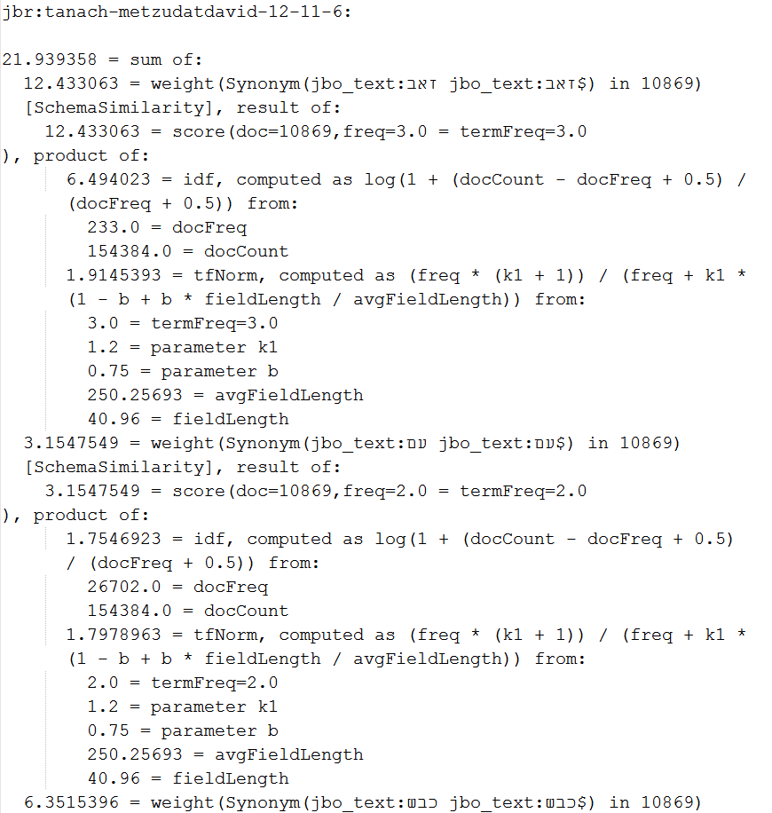
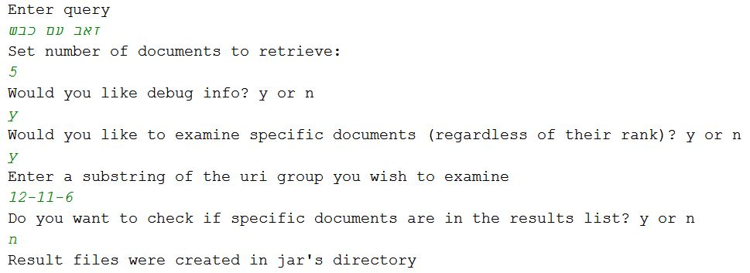
Evaluation tool example
The two images below demonstrate the operation of the tool and an example result file

Slide 16

Web UI
Solr provides a basic and generic UI for searching
The web UI is based on Apache Velocity
Java-based template engine that provides a template language to reference objects defined in Java code
We customized it so it would
Fit better to our needs
Have a cleaner and friendlier look
Be aligned with Hebrew text
Highlight query terms in results

Slide 17
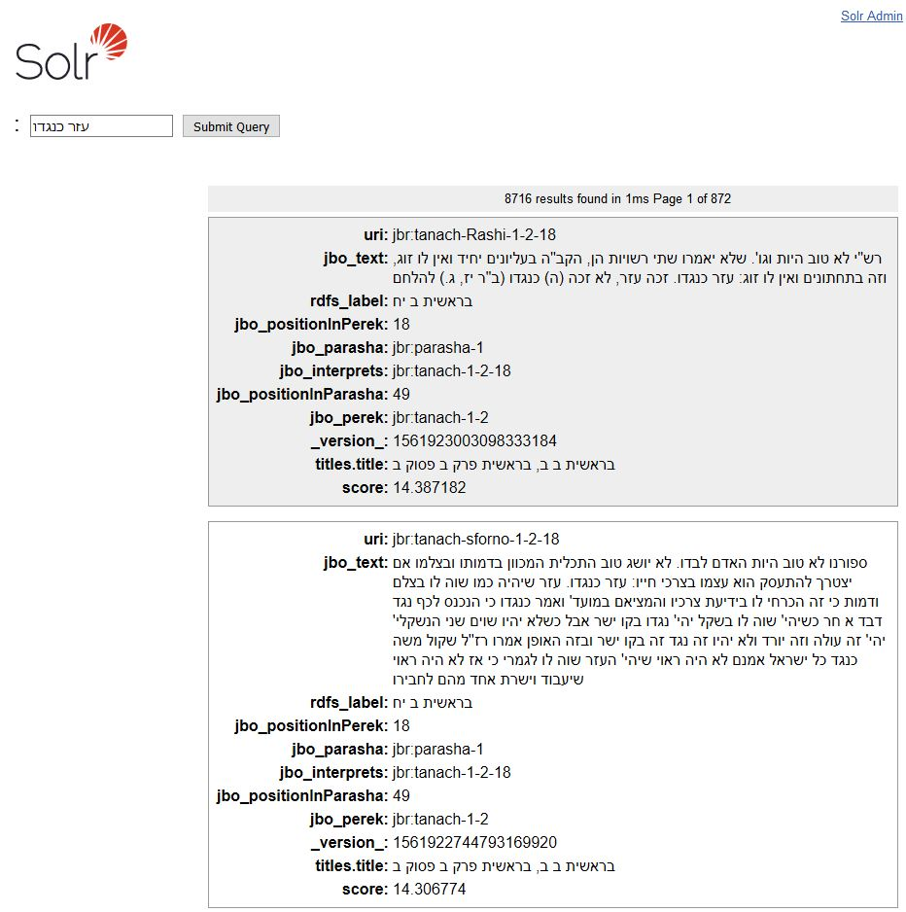
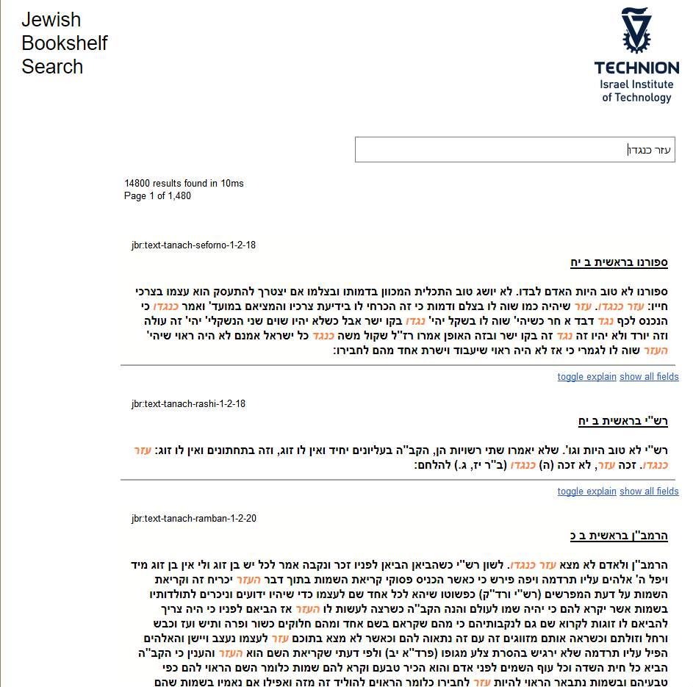
Customized Web UI
Default UI
Customized UI

Slide 18

Challenges (1)
Defining the search task and the information need
We have to know who is our user, what is he searching for and what are his expected results
Selecting the most suitable search engine platform, considering
APIs
Documentation
Long term maintenance

Slide 19
Challenges (2)
Dealing with Hebrew text
The Hebrew language structure is a very complex, hence simple stemming algorithms as for English cannot be applied
Evaluation of the engine’s performance
We need to know what are the relevant documents for a given query
Also, we need to see if the current configuration satisfies the information need of the users

Slide 20

Where can we go from here?
Try to improve HebMorph analyzer so it will better suit our domain
Explore more Solr configuration options
Enable user feedback or hand over to a focus group of potential users, in order to better understand the pitfalls
Fine tune the web UI

